Slide 1


GOVERNMENT ENGINEERING COLLEGE
RAICHUR-584135
Welcome to project phase-1 presentation
On
“soil classification and crop suggestion using machine learning”
Presented by
MOHD KHALEEL AHMAD 3GU18CS014
ALTAF 3GU20CS400
TIRAJ 3GU20CS407
VAISHNAVI 3GU20CS409
Under the guidance of
PROF. SUSHMA T SHEDOLE
Asst.Professor,
Department of Computer Science &
Engineering

Slide 2
ABSTRACT
In the last few decades researchers are interested in land mapping and its classification due to various reasons.
Agriculture research is the major source of economy for the country.
Soil is an important key factor for agriculture .There are several soil varieties in India.
In order to predict the type of crop that can be cultivated in that particular soil type we need to understand the features and characteristics of the soil type.
Machine learning techniques provides a flexible way in this case.
Classifying the soil according to the soil nutrients is much beneficial or the famers to predict which crop can be cultivated in a particular soil type
Several type of machine learning algorithms are used such as K-Nearest Neighbour (k-NN), Bagged tree, Support vector machine(SVM) and logistic regression.

Slide 3

CONTENTS
Introduction
Literature Survey
System Requirements
Existing System
Proposed System
Methodology
Conclusion

Slide 4
INTRODUCTION
Soil possess different senses for different people like it is the products of past surface processes for a geologist.
Similarly, for a penologist, it is a chemical and physical process currently occurring.
In India, Soil is particularly the basic and most essential entity for the agricultural Domain.
The product quantity losses can be reduced and the quality of the crop can be improved if the characteristics of the soil can be recognized.
It is very important for countries that have several agricultural commodities to be export.

Slide 5
LITERATURE SURVEY
[1] A.Irias and etal; ‘Algorithm of weed detection in crop by computational Vision’ CONIELECOMP 2019, 29rd International Conference on Electronics, Communications and Computing ©2019 IEEE
This research has been based on the use of precision agriculture tools for the management of weeds in crops.
It has focused on the creation of an image-processing algorithm to detect the existence of weeds in a specific site of crops.
The main objective has been to obtain a formula so that a weed detection system can be developed through binary classifications.

Slide 6
Continues
[2].J carlo et,al. ‘Vision System for Soil Nutrient detection Using Fuzzy Logic’ Proceedings of TENCON 2018 - 2018 IEEE Region 10 Conference (Jeju, Korea, 28-31 October 2018)
Several methods exists to identify the nutrient content of the soil.
The most popular method is by using Soil Test Kit (STK).
STK gives soil qualitative level of macronutrients and pH. Chemicals that change color upon reaction with soil samples can determine macronutrients such as nitrogen, phosphorus, and potassium.

Slide 7
SYSTEM REQUIREMENTS
HARDWARE REQUIREMENTS
System
Hard Disk
Monitor
Mouse
RAM
Pentium IV 2.4 GHz.
: 100 GB.
: 15 VGA Color.
: Logitech.
: 4 GB.

Slide 8
SOFTWARE REQUIREMENTS
The software requirements specify the use of all required software products
Operating system : Windows XP/7/10
Development framework : flask framework
Programming language : Python
Dataset : Soil types dataset
IDE : Anaconda prompt

Slide 9
EXISTING SYSTEM
The authors observed that the number of classification algorithms is available in remote sensing methods like minimum distance, maximum likelihood, support vector machine, K-NN, and multilevel classification.
Another algorithm in vision séance is developed in by A Iriars and others. This group of researchers developed an algorithm for ‘weed detection in the crop by computational vision
A binary classification method was used in this approach. As like [4], researches of this method also consider an image as an input and perform the feature classification with a binary method

Slide 10
PROPOSED SYSTEM
A classification of the soil and identifying the quality level to which a soil belongs and what contents of the soil need to be improved can define the type of the soil.
Knowing such a class or type of soil can be very useful for cultivation.
For analyzing the type of soil in a specific geographical area can be done by collecting soil samples of that area and using different machine learning algorithms classifying them into various classes.
With the emergence of machine learning and its implementation in image processing, the soil sample can be classified efficiently into class to which it belongs.

Slide 11
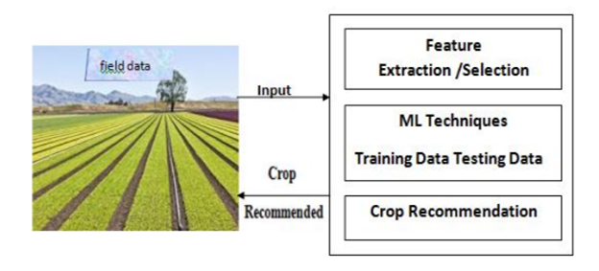

Slide 12
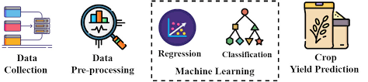

Slide 13
METHODOLOGY
Image Preprocessing :
The images in dataset is preprocessed before going to the next step. In the preprocessing step, the image is transformed into a grayscale image because the RGB color image contains so much redundant information that is not necessary for soil detection.
RGB color image stored 24 bit for each pixel of the image. On the other hand, the grayscale image stored 8 bit for each pixel and it contained sufficient information for classification. Then, we reshaped the images into (64×64) shape to maintain uniformity of the input images to the architecture.
Deep Learning Architecture:
The deep learning architecture learns various important nonlinear features from the given samples. Then, this learned architecture is used to predict previously unseen samples.
To train our deep learning architecture, we collected images from different sources. The architecture of the learning technique highly depends on CNN. All the aspects of deep learning architecture are described below

Slide 14
Dataset Collection:
Data from two different sources are collected for training and testing the model. We collected a total of 4 types of soil classes images with each images of 30 images.
For training purposes, 80% images of each class are used and the rest of the images are utilized for testing purposes.
Architecture Development
The learning model is based on CNN which is very useful for pattern recognition from images. The network comprises an input layer, several hidden layers and an output layer.
The hidden layers consist of multiple convolution layers that learn suitable filters for important feature extraction from the given samples. The features extracted by CNN are used by multiple dense neural networks for classification purposes.

Slide 15
Advantages
The good classifier should handle diversity in the land. It should be hierarchical for deep classification with maximum accuracy.
classifying various kinds of soil series data along with a suitable suggestion for improving the fertility of the soil by detecting the health of the soil

Slide 16
CONCLUSION
This project surveys the different algorithms and methodologies associated with the land classification and in this paper, it has been attempted to identify a method for detecting the nutrient level in the soil.
Organic matters play a vital role in soil health. Uses of organic matters are good in séance of increasing water-holding capability and to provide major, minor, and micronutrient to the plant.

Slide 17
REFERENCES
[1] E. Ben-Dor et al., “Using imaging spectroscopy to study soil properties,” Remote Sens. Environ., vol. 113, pp. S38–S55, 2009.
[2] K.Kulkarni et al., ‘ Classification Using Remotely Sensed Data’ International Conference on Computing Methodologies and Communication (ICCMC) Proceedings of the IEEE 2017
[3] Factor affecting crop production-climate- edaphic pbiotic,Physiogaphic and socioeconomic ,eagri.org › eagri50 › AGRO101 › lec09
[4] J carlo et,al. ‘Vision System for Soil Nutrient detection Using Fuzzy Logic’ Proceedings of TENCON 2018 - 2018 IEEE Region 10 Conference (Jeju, Korea, 28-31 October 2018)

Slide 18


